Slide 1
https://domains.google.com/
Notes:
https://www.softwareag.com/corporate/services/training/learn_natural.html
https://github.com/SoftwareAG
https://www.youtube.com/playlist?list=PL3HwmrSYjxiOScRUnxfO_Pv_yrhVGSh7o

Slide 2
Spring Web Services
https://trentyang.com/how-to-setup-google-domain-for-github-pages/
https://help.github.com/en/articles/troubleshooting-custom-domains
https://help.github.com/en/articles/using-a-custom-domain-with-github-pages
https://peris.dev/
https://dev.to/trentyang/how-to-setup-google-domain-for-github-pages-1p58
https://medium.com/@Tnylnc/tnylnc-how-to-set-up-github-pages-with-google-domains-83bd5a4fbc5c

Slide 3
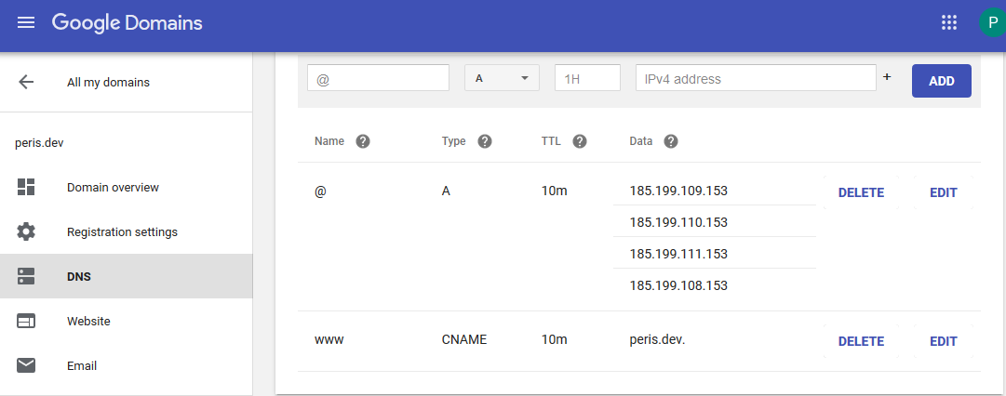
Spring Web Services

Slide 4
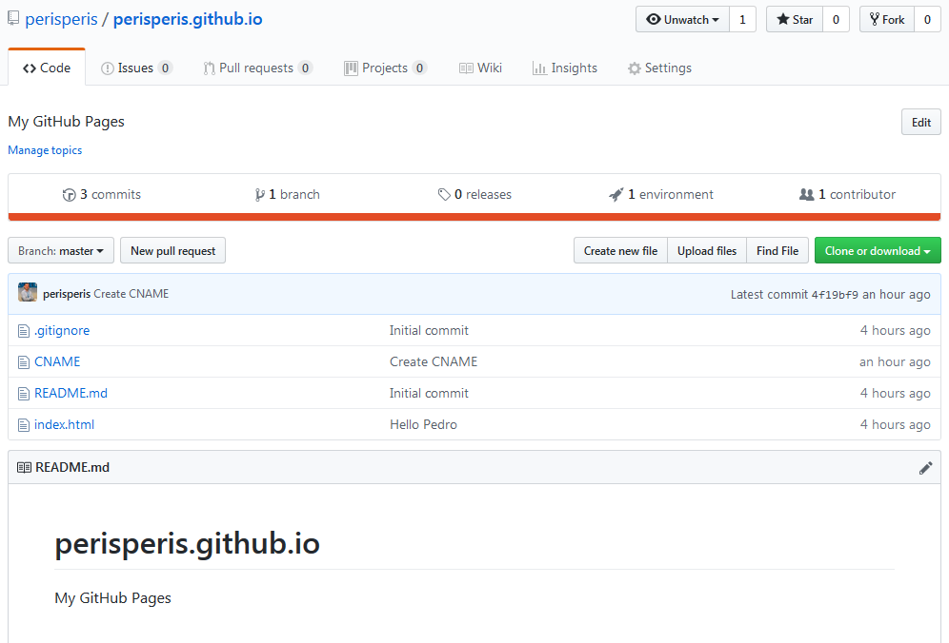
Spring Web Services

Slide 5
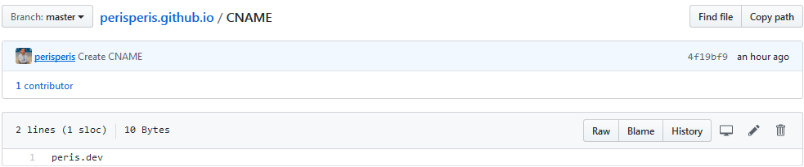
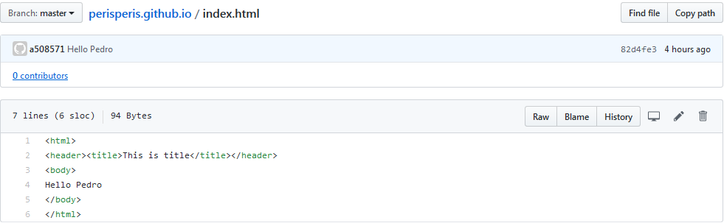
Spring Web Services

Slide 6
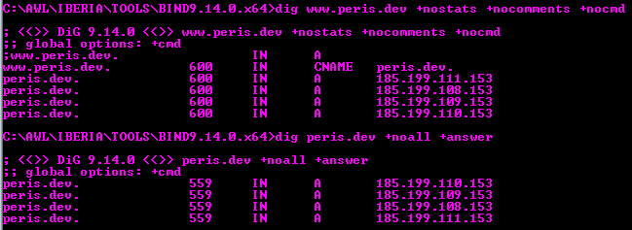
Spring Web Services

Slide 7
Thank you !

